Slide 1

Final Project Presentation
MTH-9899
Raveesh Soni, Mukesh Pant, Jose Ferreira

Slide 2
Overview: Problem Description
Future stock return prediction
Goal: Apply the various ML algorithms you have learned in this class to a real-world financial dataset.
Data: The dataset you will be given consists of approximately 400k rows of data with 7 features. Each row represents an observation. It is your discretion whether to keep them all, consider a subset, or maybe even enlarge it.
Columns
Date: The date is an int - it does correspond to real dates in the same order
Time: Can be ignored. All of the points occur at the same time and the future return is measured roughly 1 day in the future.
fut_ret: This is the dependent variable
sec_id: This is an identifier for the security that will not change over time.
vol: This is a proxy for the stock's volatility
X*: There are 7 cols with names that start with 'X' - those will be the features that you might consider using for your models

Slide 3





Overview: Our Approach
Data Analysis
Data Cleaning
Feature Selection
Model Selection
Parameter Tuning
Split by security
K-means clustering
Discard incomplete data
Fill blanks
Stationarity and fractional differentiation
Polynomial features
MDA and RFE selection
Cross-validation
Model evaluation
Grid search
Paramter Search

Slide 4
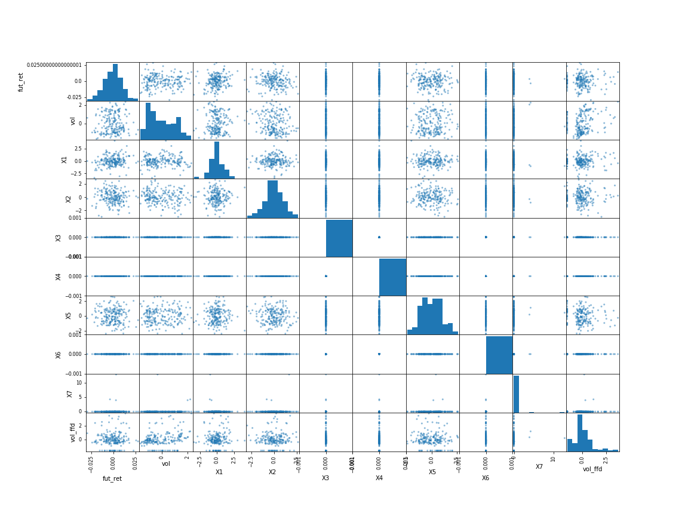
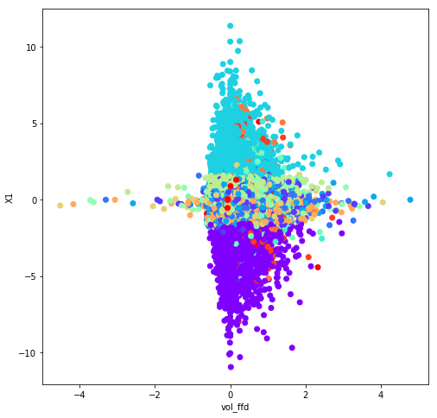
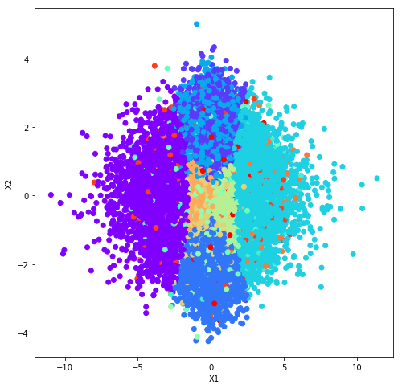
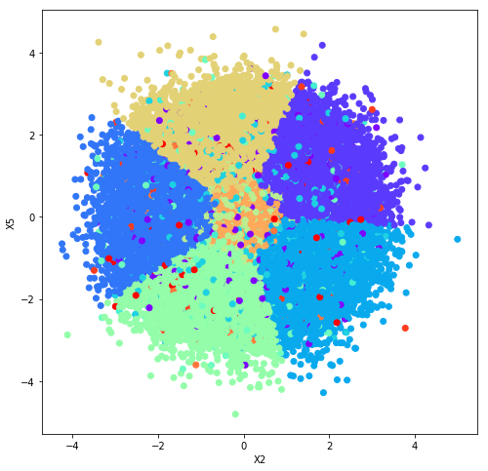
Data Analysis
Time-series by security view, clustering for cross-sectional view
Time-series scatter matrix for a random security

Slide 5
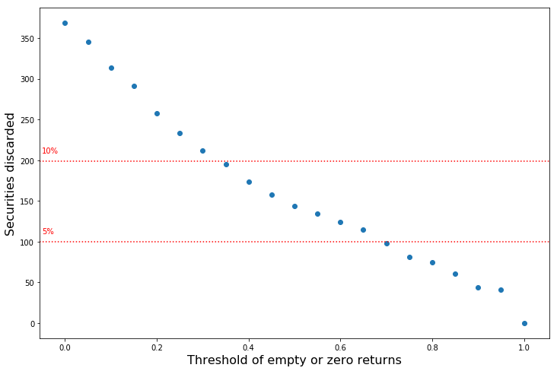
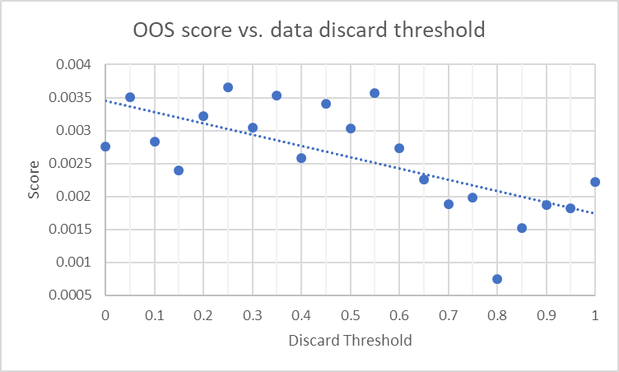
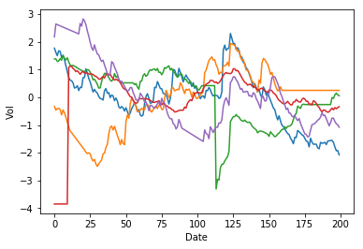
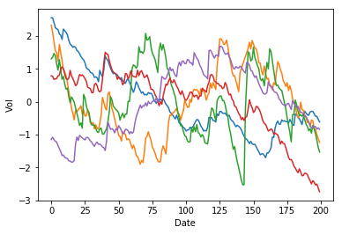
Data Cleaning
Data cleaning the most important piece before starting any Machine learning Algorithm
Discard securities with more than a threshold percentage of returns missing (or zero).
For the remaining N/A values, fill with the previous value in the time-series when it exists, fill with the dataset’s median value for that variable when it doesn’t.
Normalize the variables using the time-series per security rather than the cross-sectional data.
Normalize again across the entire dataset when all the features have been selected.

Slide 6
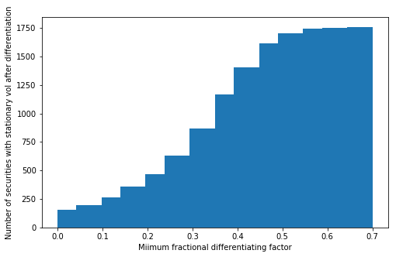
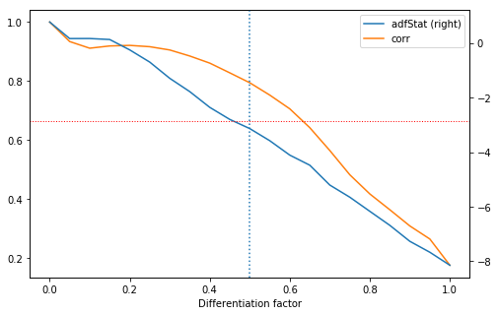
Feature Selection: Stationarity and Fractional Differentiation
Preserve memory while ensuring stationarity
The ‘Vol’ variable is not stationary. A common approach is to use a lagged variable to make it stationary. However, this would remove all memory of previous values.
A way to preserve some of the memory is fractional differentiation (see textbook for details).
We established the minimum value of the fractional differentiation factor that makes all the ‘Vol’ series per security stationary (determined by the Augmented Dickey-Fuller unit root test) to be 0.7.

Slide 7
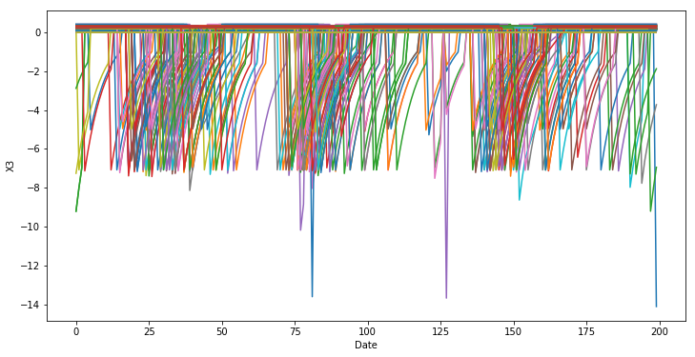
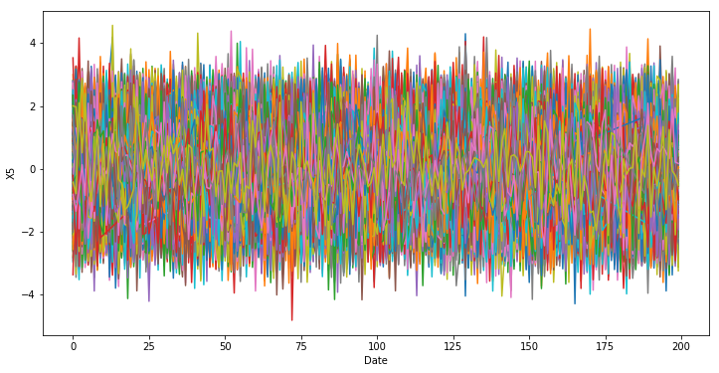
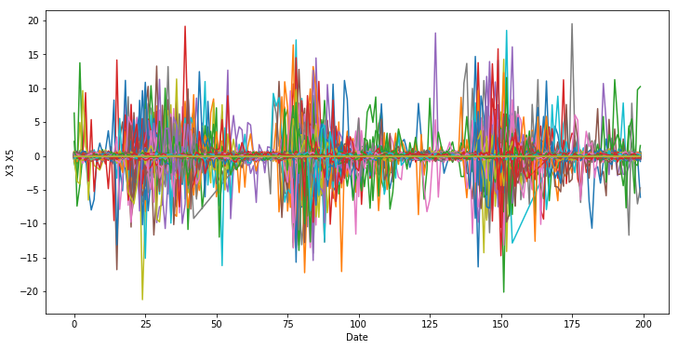
Feature Selection: Polynomial Features
More power of expression for the estimators
After analysis of the input variables, we thought a combination of them could be more significant than using them independently.
For instance, variables ‘X3’, ‘X4’ and ‘X6’ seem to represent decay functions starting from an event in the security’s time series. Variable ‘X7’ seems to indicate another type of punctual event in time. Multiplying them with other variables in the dataset can be beneficial.
We included polynomial combinations of second degree in the model and selected the best using feature selection algorithms (to be explained in the following slides).
Including the best polynomial combinations increased our R² scores by approximately 3-5 bps.

Slide 8
Feature Selection: RFE
We use Recursive Feature Elimination algorithm as a challenger to MDA to select features
Recursive feature elimination (RFE) is a feature selection method that fits a model and removes the weakest feature (or features) until the specified number of features is reached. Features are ranked by the model’s coefficient ( Linear Regression in our case ) since we use Linear regression as a weak learner
RFE requires a specified number of features to keep, however it is often not known in advance how many features are valid. To find the optimal number of features we used cross-validation to score different feature subsets and select the best scoring collection of features

Slide 9
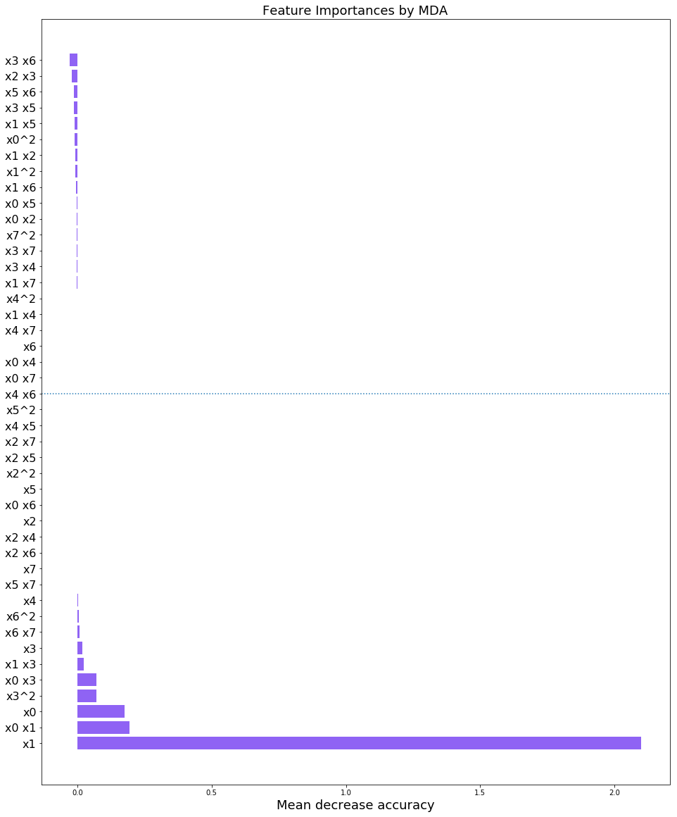
Feature Selection: MDA (Mean Decrease Accuracy)
Determine importance of features by permutation
Fit an estimator and calculate a score. Then, permutate the values in each feature and calculate the score again. The difference between these two scores is a measure of how important the feature is. Run many times and accumulate the results for accuracy.
Does not discover importance of combinations of variables.
Can be used with any estimator, we used Lasso linear regression as this method is known to help selecting features and it offered a good balance between accuracy and speed.
We selected the top half of the features according to the MDA importance score.

Slide 10
Model Selection
Tried different models and ensembles and chose model with highest OOS r square. We also tried ensembles of Clustering (K means) and then running different models
Model/Ensemble | In sample R square | OOS R Square
Linear Regression | 0.1218% | 0.1716%
Random Forest (BEST) | 0.5055% | 0.3591%
Gradient Boosting (BEST) | 0.9609% | 0.4852%
K means cluster + Linear Regression | 0.2640% | 0.1254%
K means cluster + Gradient Boosting | 1.4626% | 0.1491%
LSTM | 0.0722% | 0.1605%

Slide 11
Parameter Tuning
Grid Search and parameter search to select the best combination of model parameters. We need to tune the following parameters for Gradient Boosting Machine:
Learning Rate: Learning rate shrinks the contribution of each parameter, this helps to not overfit the model
No of estimators: This represents the number of trees in the forest, increasing the number of trees may lead to over fitting so we need to choose the parameter carefully
Max Depth: This indicates how deep the tree can be, the deeper the tree, the more splits it has and it could lead to over fitting of data
Min Samples Split: This represents the minimum number of samples required to split an internal node
Min Samples Leaf: This is the minimum number of samples required to be at the leaf node

Slide 12
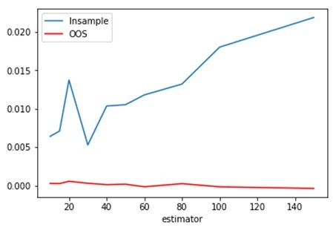
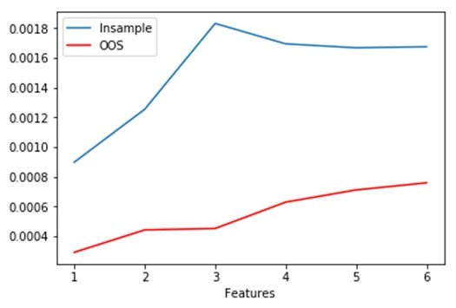
Parameter Tuning(Contd….)
Parameter Search: We can run in sample and OOS r square by different parameters ( keeping others constant) and see which parameter value produces highest OOS r square. See images below.
Although this method looks good but is naïve and arduous and does not test combinations
We finally use Grid Search CV from scikit learn to tune hyper parameters for GBM algorithm because it has below advantages
Tests all Combinations
Does Cross Validation
Finally GBM gives us an OOS r square of 25 bps which looks dismal but is as per expectations

Slide 13

Thank You

